Slide 1


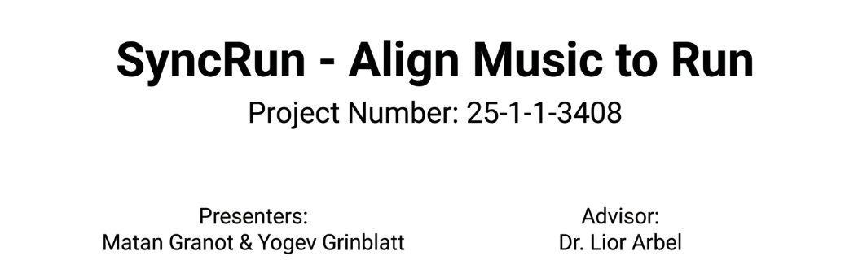

Slide 2
Project Overview
•SyncRun dynamically adjusts the playback rate of a rhythmic music track to seamlessly match a runner's offline step rhythm.
•It uses advanced time-stretch algorithms to synchronize musical beats with physical steps, without altering the original pitch.

Slide 3
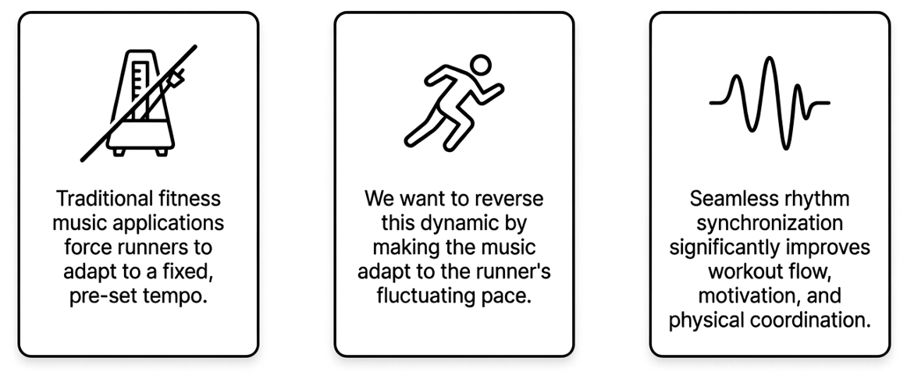
Motivation

Slide 4
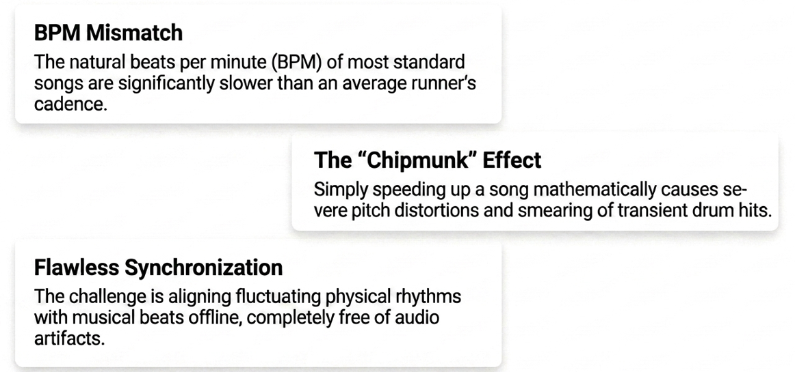
Problems

Slide 5
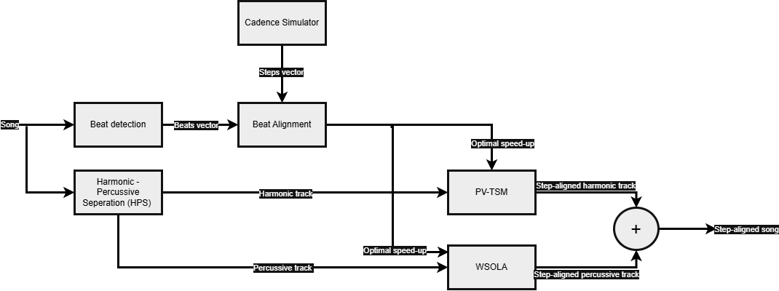
Block Diagram

Slide 6
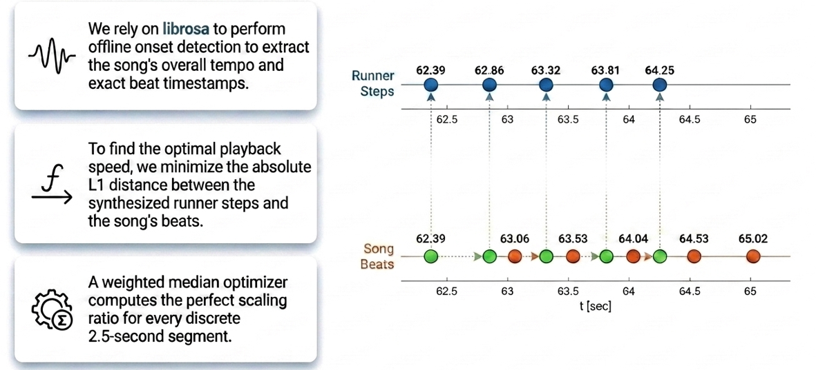

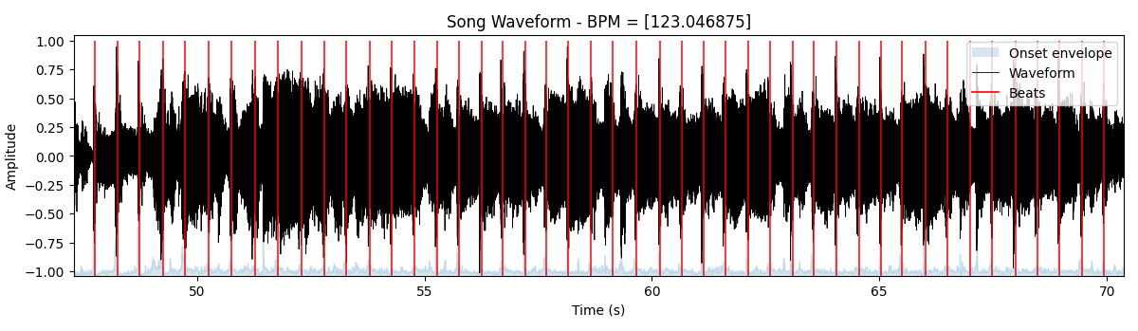
Beat Detection
Input song + clicks on beat

Slide 7
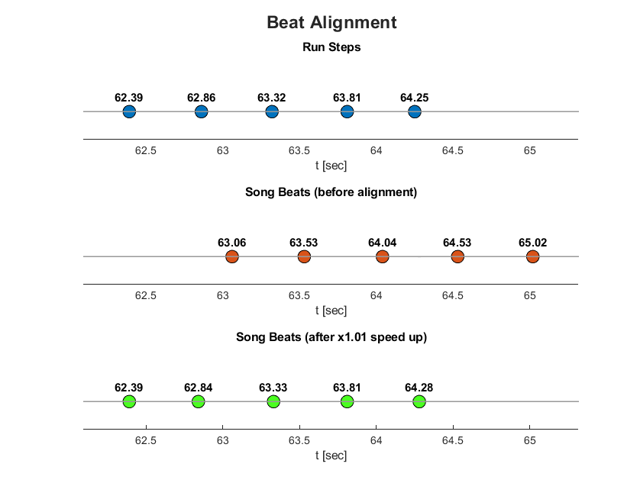

Beat Alignment

Slide 8
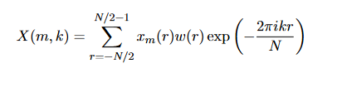
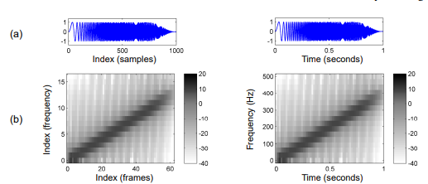
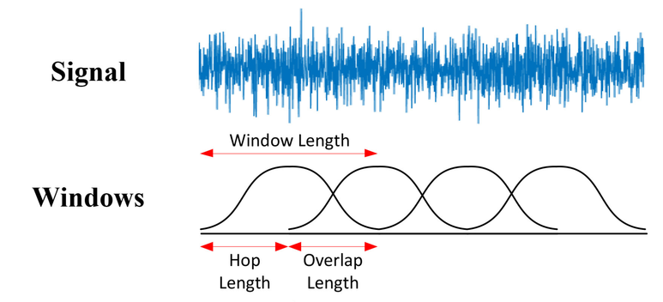
Our main weapon: Short-Time Fourier Transform (STFT)
The audio is first transformed from the time domain into the frequency domain. We utilize a window size of 2048 samples with a 75% overlap to ensure smooth reconstruction and phase coherence.

Slide 9
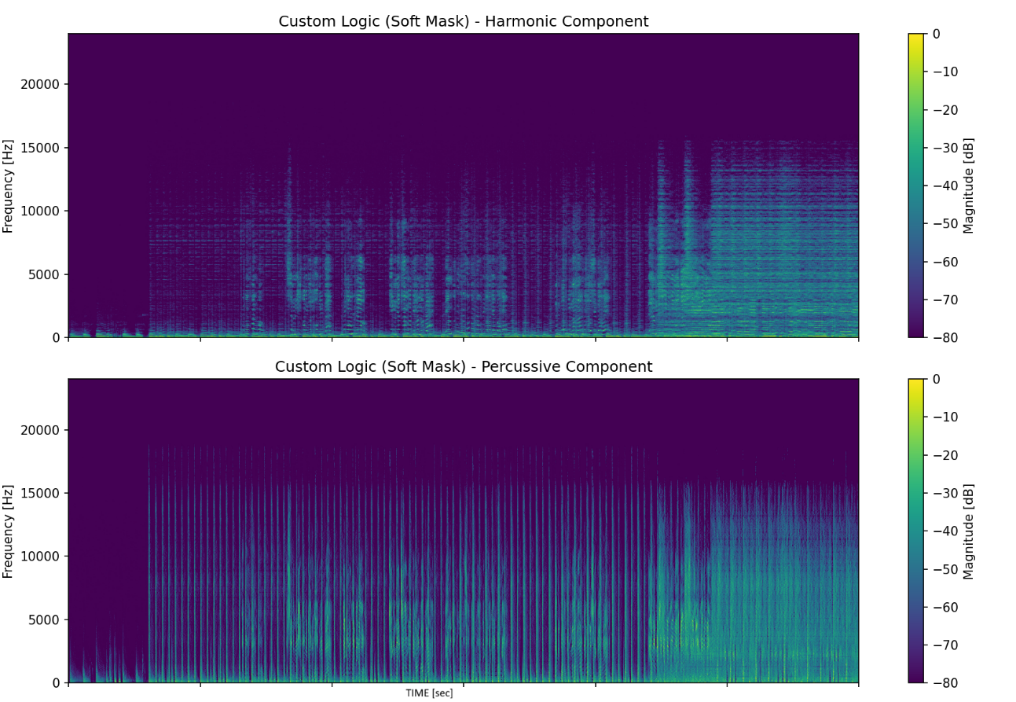
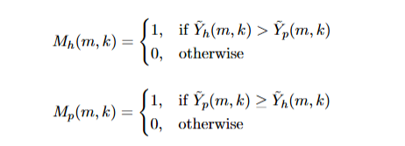
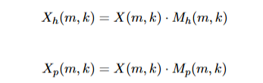
Harmonic – Percussive separate (HPS)
We applied median filters to separate the original audio into its sustained, pitched sounds (harmonic content) and sharp, transient drum hits (percussive content)
And created binary masks are applied pointwise to the original complex STFT X(m,k) to isolate the complex frequency representations of each component

Slide 10
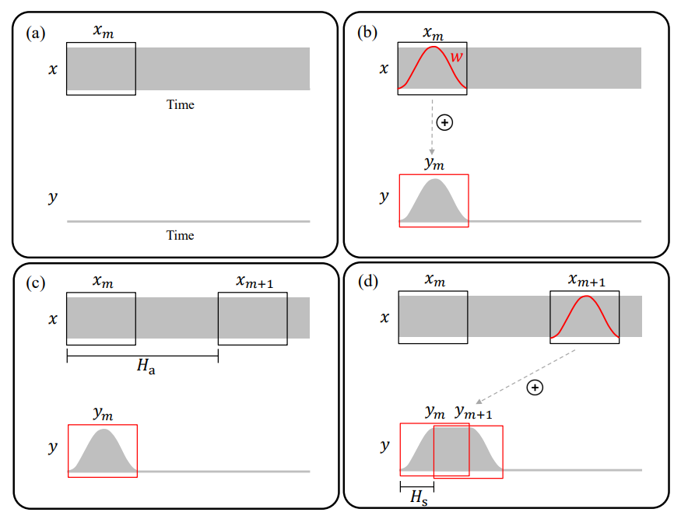
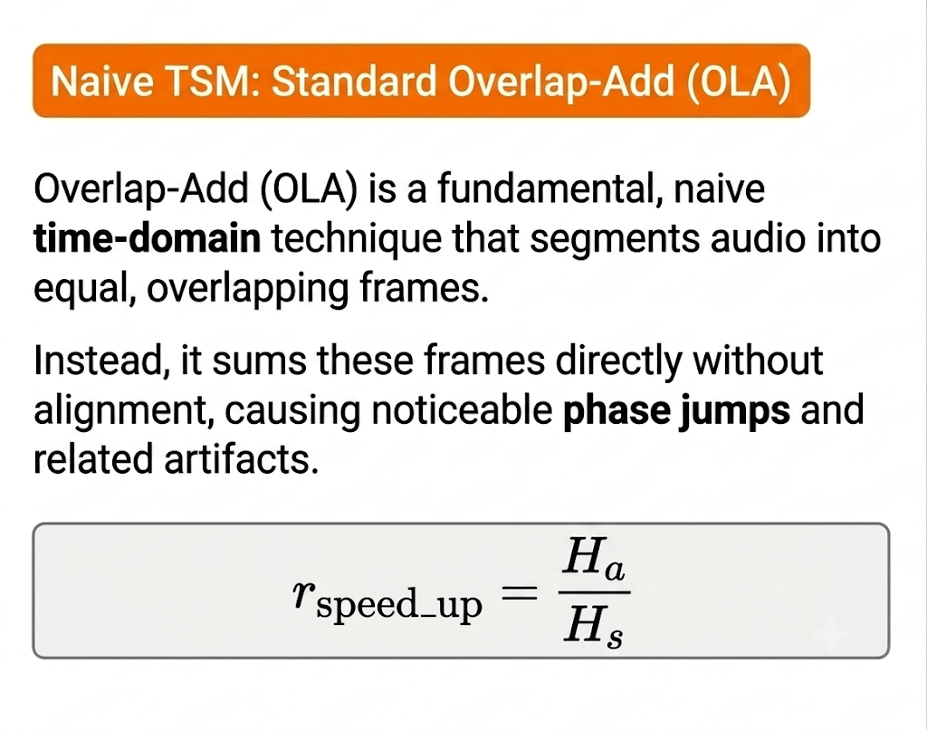
OLA – good, but not for us

Slide 11
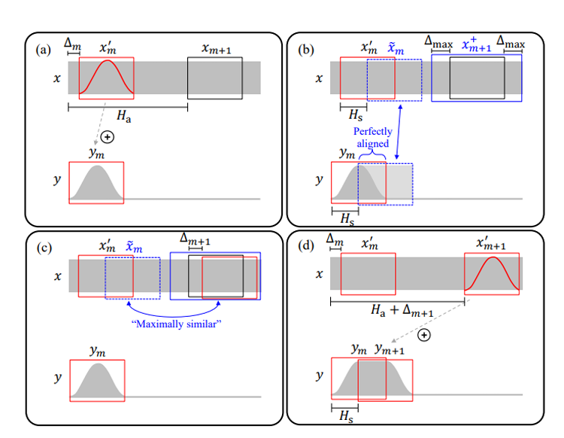
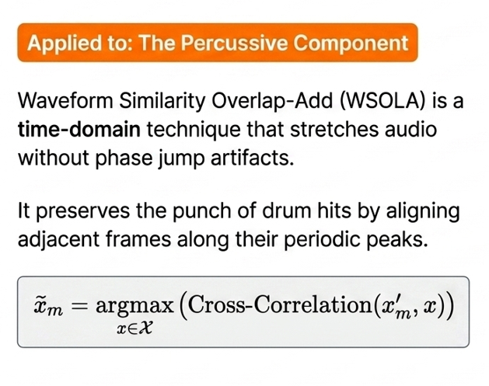
WSOLA

Slide 12
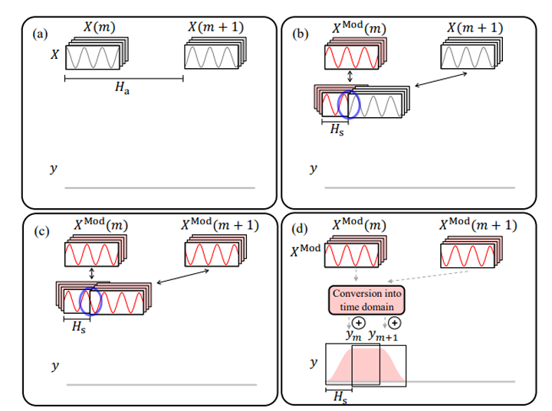
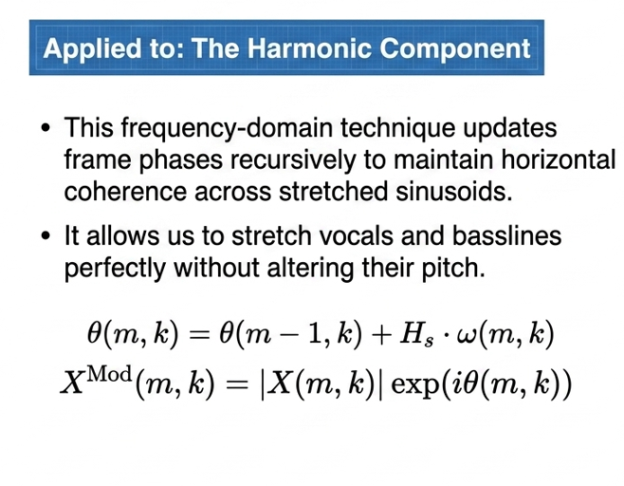
Phase Vocoder TSM

Slide 13
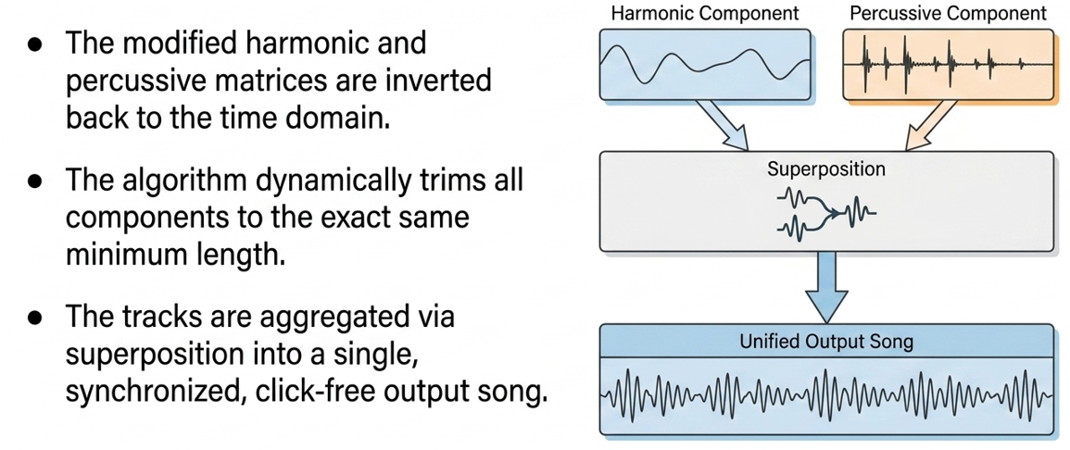
Reconstruction

Slide 14
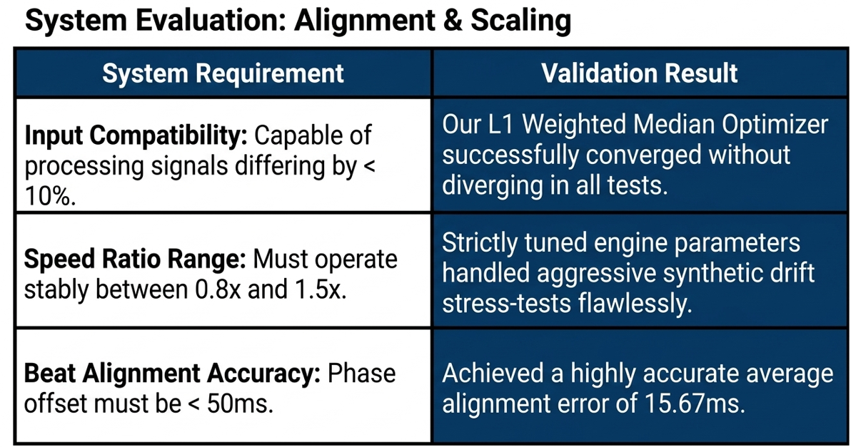

Slide 15
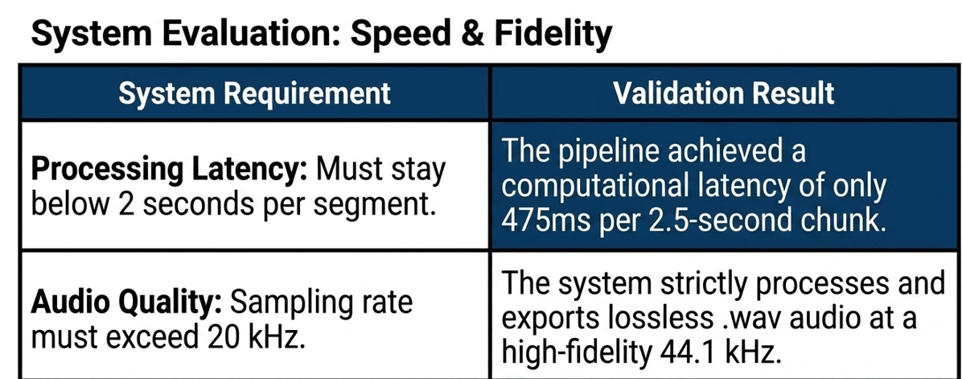

Slide 16
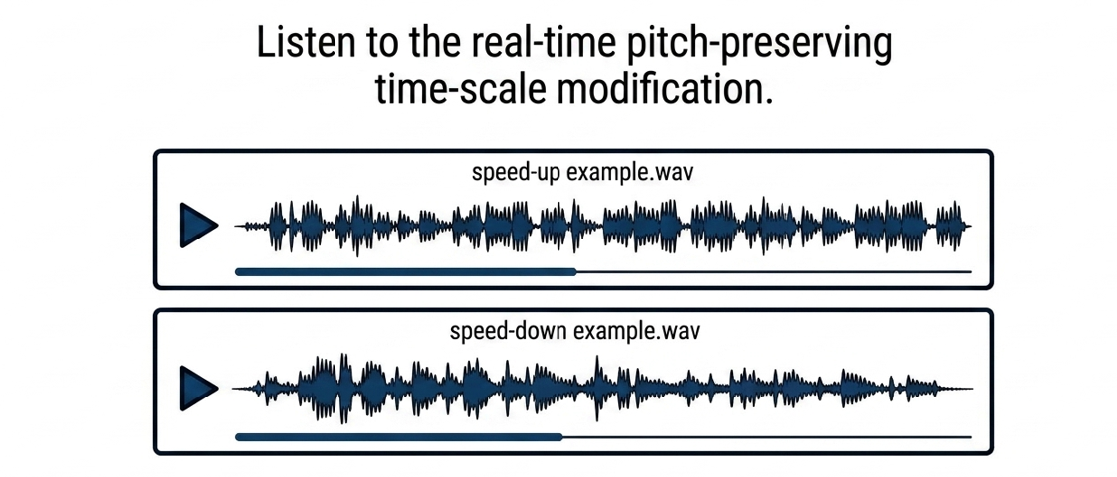

Slide 17
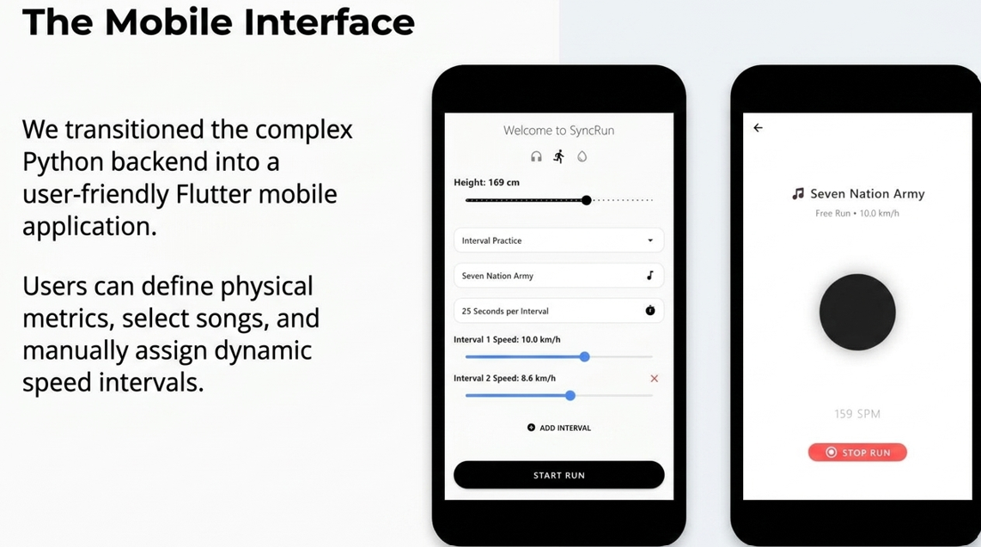

Slide 18
Future Work
Transition to real-time, adaptive tempo adjustments using live biometric feedback from smartwatches, accelerometers, and barometers.
Shift processing directly to the mobile device and integrate with commercial platforms like Spotify to synchronize personalized playlists on the fly.

Slide 19


